Slide 1
Operating Systems
Introduction
(Week 1)

Slide 2
Contact
Name: Dr. Mansoor Ebrahim
E-Mail: mebrahim@iqra.edu.pk
Room: 8th Floor, Faculty Room

Slide 3
Assessment
Coursework = 60%
Quiz = 10%
Assignment = 10%
Presentation = 15%
Mid Term = 25%
Final Exam = 40%

Slide 4
Aims & Objectives
This course introduces the essential concepts in the design and implementation of modern multiprogramming operating systems. Specific examples of such operating systems, the services provided, the way those services are implemented, and the underlying problems and solutions encountered in a multiprogramming computer system environment are covered.
Learning Outcomes
It will enhance the skills of students in the field of Operating Systems, especially how Distributed System works, and how resources are shared in a distributed system, as distributed systems are the most expanding and largely used nowadays in the field of computer communication.

Slide 5
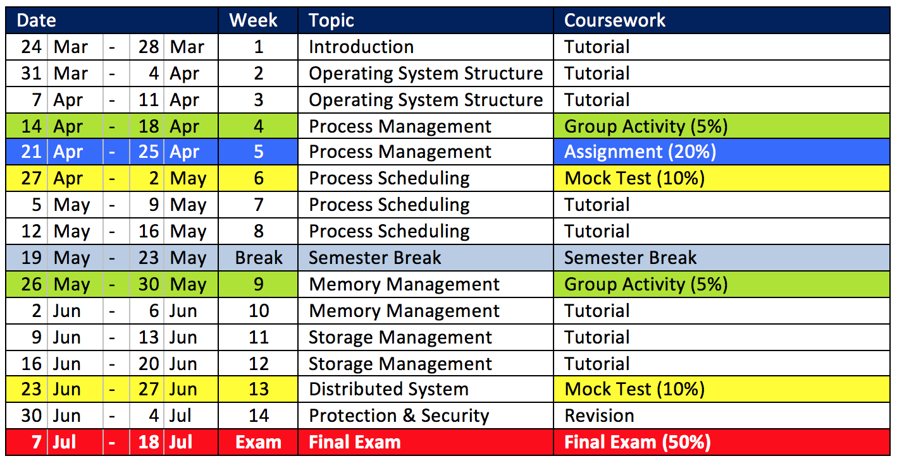
Plan…Plan…Plan…

Slide 6
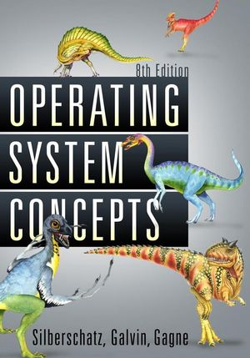
The SO CALLED “TEXTBOOK”…
Operating System Concepts
Abraham Silberschatz
Peter B. Galvin
Greg Gagne
A.K.A – The Dinosaur Book

Slide 7
Plan…Plan…Plan…

Slide 8
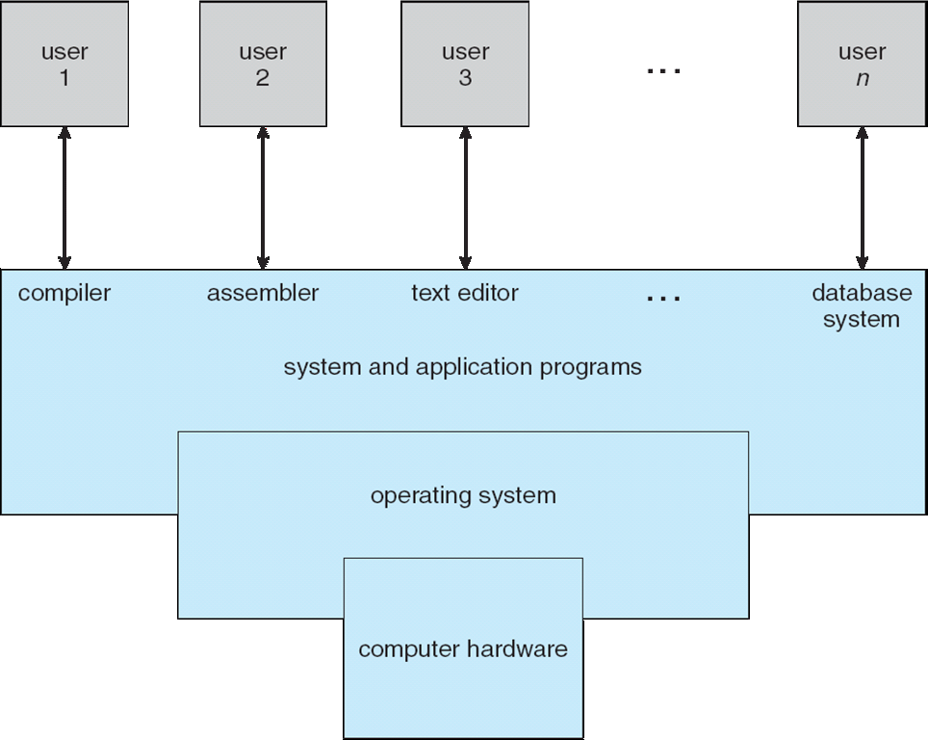








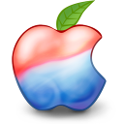
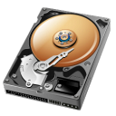
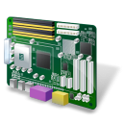
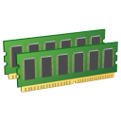
Four Components of a Computer System
compiler
assembler
text editor
database system
system and application programs
operating system
computer hardware

Slide 9

What is an Operating System?

Slide 10
What is Operating System?
An Operating System (OS) is an interface between a computer user and computer hardware. An operating system is a software which performs all the basic tasks like file management, memory management, process management, handling input and output, and controlling peripheral devices such as disk drives and printers.
Operating system goals:
Execute user programs and make solving user problems easier.
Make the computer system convenient to use.
Use the computer hardware in an efficient manner.

Slide 11
What is an Operating System?
Generally:
Users
System and Application Programs
Command / System Call
Operating
System
Kernel
Computer Hardware

Slide 12
What Operating Systems Do?
Operating System (OS)
An intermediary between a user of a computer and the computer hardware.
User
OS
Hardware
I’M THE MIDDLE MAN

Slide 13
What Operating Systems Do?
What do you want the OS to do for you?
Execute user programs.
Make solving user problems easier.
Make the computer system convenient to use
Use the computer hardware in an efficient manner.
User View

Slide 14
What Operating Systems Do?
What the computers want the OS to do?
Resource Allocator
Manage all resources (memory, storage, etc).
Efficient and fair resource use.
Control Program
Controls execution of programs.
Prevent errors and improper use of the computer.
System View

Slide 15
Computer Startup
bootstrap program is loaded at power-up or reboot
Typically stored in ROM or EPROM, generally known as firmware
Initializes all aspects of system
Loads operating system kernel and starts execution

Slide 16
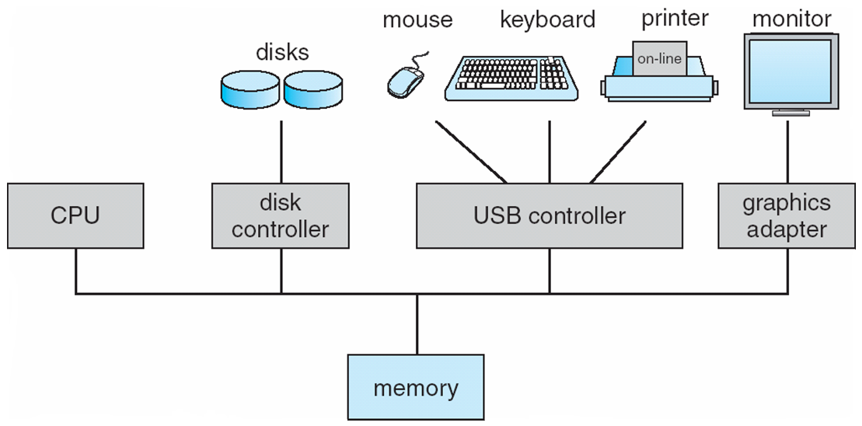
Computer System Organization
Computer-system operation
One or more CPUs, device controllers connect through common bus providing access to shared memory
Concurrent execution of CPUs and devices competing for memory cycles

Slide 17
Computer-System Operation
I/O devices and the CPU can execute concurrently
Each device controller is in charge of a particular device type
Each device controller has a local buffer
CPU moves data from/to main memory to/from local buffers
I/O is from the device to local buffer of controller
Device controller informs CPU that it has finished its operation by causing an interrupt

Slide 18
Common Functions of Interrupts
Interrupt transfers control to the interrupt service routine generally, through the interrupt vector, which contains the addresses of all the service routines
Interrupt architecture must save the address of the interrupted instruction
A trap or exception is a software-generated interrupt caused either by an error or a user request
An operating system is interrupt driven

Slide 19
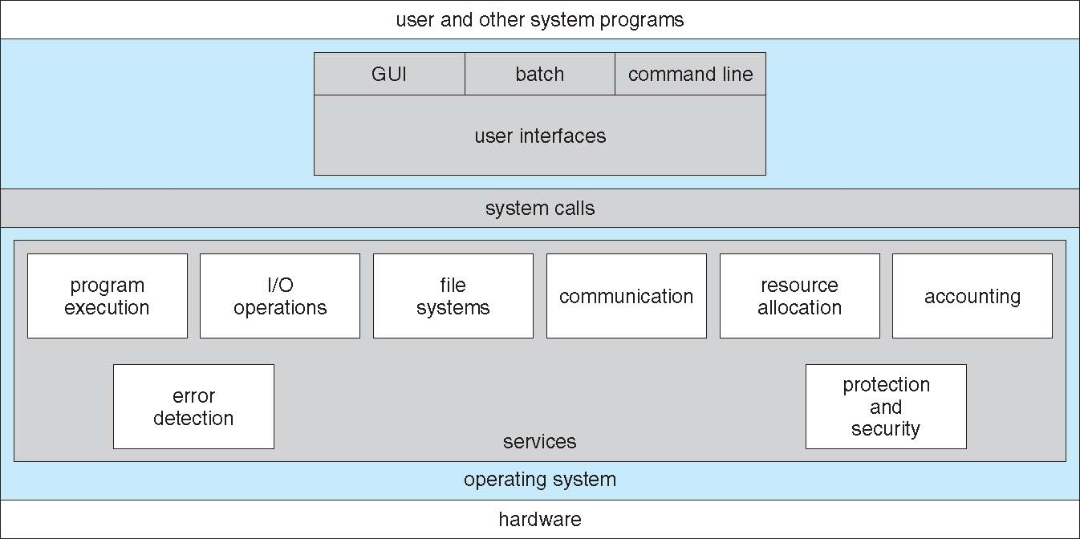
What is an Operating System?
A More detail version:

Slide 20
Plan…Plan…Plan…

Slide 21
Operating System Structure
Services provided by OS.
Different ways of structuring the OS.

Slide 22
What is an Operating System?
Generally:
Users
System and Application Programs
Command / System Call
Operating
System
Kernel
Computer Hardware

Slide 23
Structuring of Operating System
Each OS may structure it’s kernel in different approaches.
Monolithic
Layered
Microkernel
Modular

Slide 24
Plan…Plan…Plan…

Slide 25
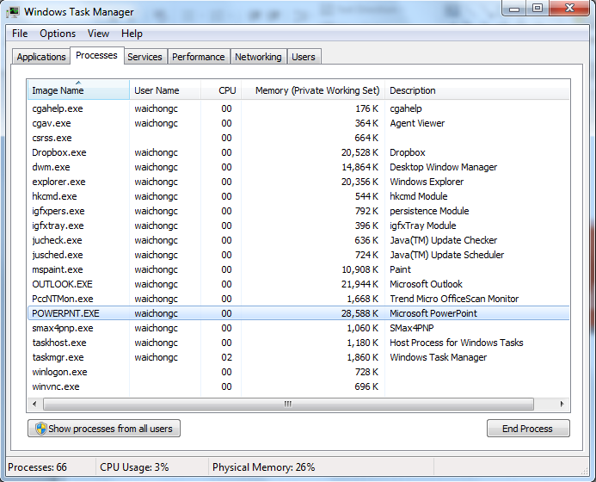
Process Management
How OSs manage them?

Slide 26
Process Management
A process is a program in execution.
Process needs resources to accomplish its tasks.
OS Activities:
Allocate resources.
Create and delete the process.
Pause and resume the process.
Provide mechanism for process communication.

Slide 27
Plan…Plan…Plan…

Slide 28
Process Scheduling
Sequence of execution?

Slide 29
Process Scheduling
Determines the sequence of execution.
Different types of algorithm.
First-Come First-Serve
Shortest Job First
Priority Scheduling
Round Robin
Involves some simple mathematical calculation.
Please remember to bring your CALCULATOR.

Slide 30
Plan…Plan…Plan…

Slide 31
Memory Management
How OSs manage the use of memory?

Slide 32
Memory Management
Determines what to be in the memory.
Optimizing CPU utilization and computer response to users.
OS Activities:
Keeping track of which parts of memory are currently being used and by whom.
Deciding which processes and data to move into and out of the memory.
Allocating and de-allocating memory space as needed.

Slide 33
Plan…Plan…Plan…

Slide 34
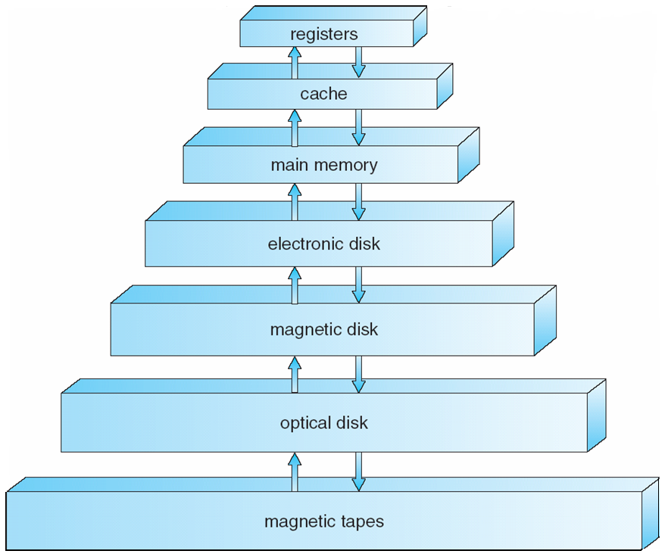
Storage-Device Hierarchy
CPU
Performance
RAM
Secondary Storage
Cost

Slide 35
Storage Management
Determines the storage of files.
OS Activities:
Manipulate files and directories.
Free-space management.
Allocation of free-space.

Slide 36
Plan…Plan…Plan…

Slide 37
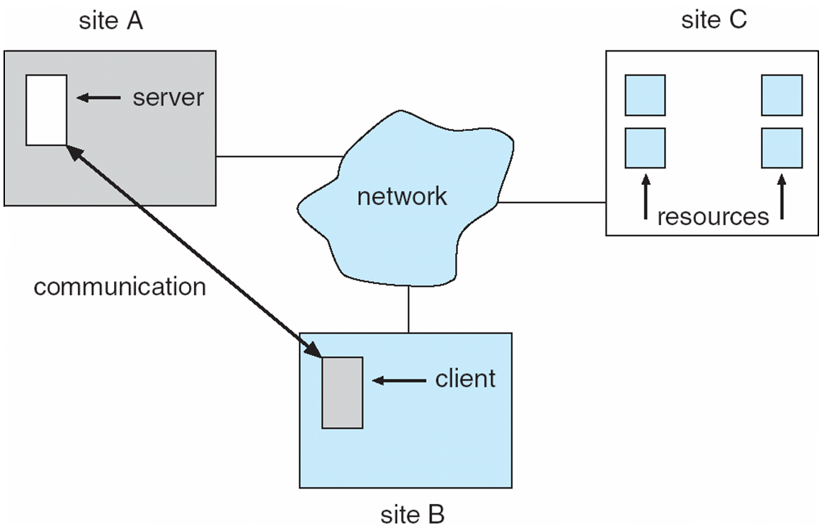
Distributed System
Collection of physically separated computer systems that are connected together.

Slide 38
Distributed System
What’re the advantages?
Gain access to various resources.
Increases:
Computation Speed
Functionality
Data Availability
Reliability

Slide 39
Plan…Plan…Plan…

Slide 40
Protection and Security
Discusses the mechanisms necessary for the protection and security of computer systems.
Basic idea is to control the authorisation of accessing different kind of resources.
Threats:
Trojan Horse
Logic Bomb
Trap Door
Denial-of-Service

